Slide 1
Information Retrieval (CS6370)
Identifying relevant prior cases
Shivangi Bithel: CS20MTECH12004
Sumitra Malagi: CS20MTECH14006

Slide 2
Problem Statement: Identifying relevant prior cases
Prior Cases
Query :Court Case
IR Model
Output: Relevant Prior case

Slide 3
Timeline
9th Oct
16th Oct
23rd Oct
30th Oct
9th Nov
Exploratory data analysis
Data Pre-Processing
Vectorization Techniques
Similarity Score and Ranking
Best Match 25

Slide 4
Timeline
16th Nov
23rd Nov
30th Nov
7th Dec
14th Dec
Sent2Vec
Sbert
Elastic Search, Rake and re-read research papers
Bert
Analysis

Slide 5
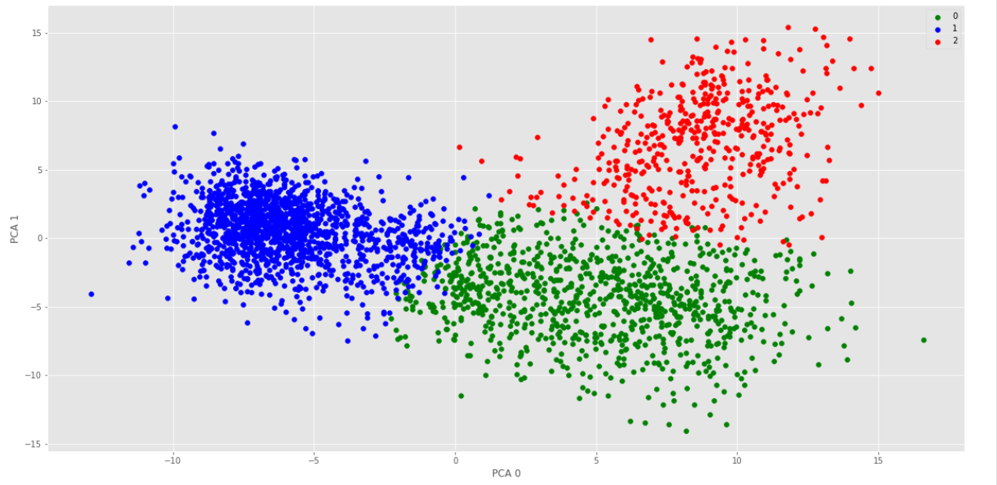
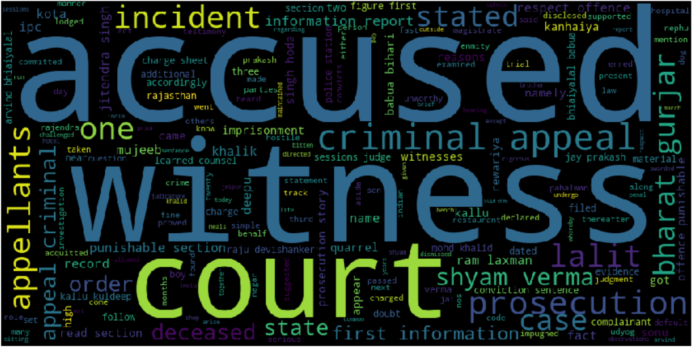
Exploratory Data Analysis

Slide 6
Pre Processing steps on Corpus
Lower Case
Stop word removal
Remove punctuation
Stemming
Remove numbers

Slide 7
Word Embeddings
Word2vec
Doc2Vec

Slide 8
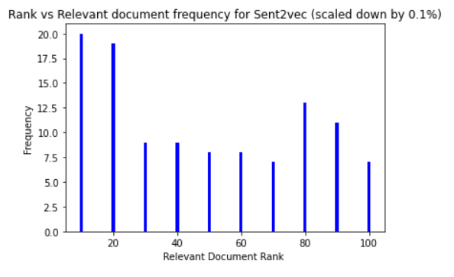
SENT2VEC
Publicly Available embedding
FastText
Code

Slide 9


TF-IDF and Cosine Similarity
TF-IDF
Cosine Similarity

Slide 10
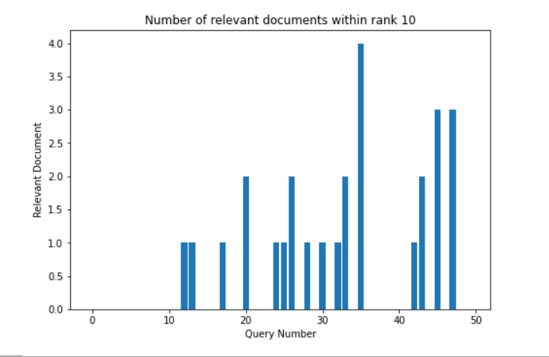

Best Match 25 (BM25)

Slide 11
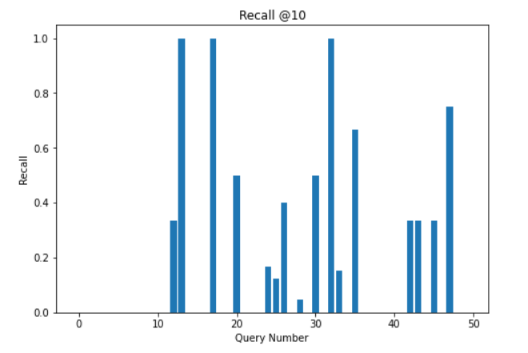
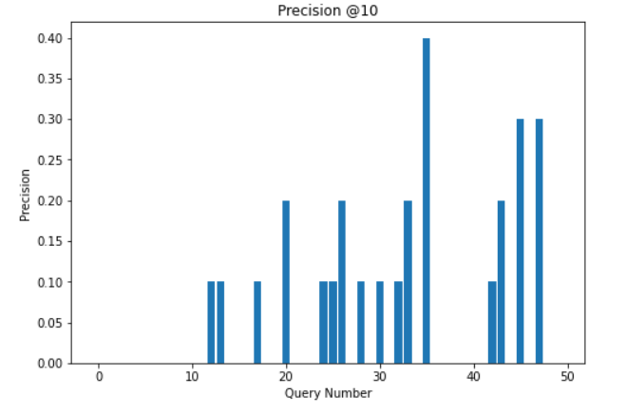
Precision and Recall for BM25

Slide 12
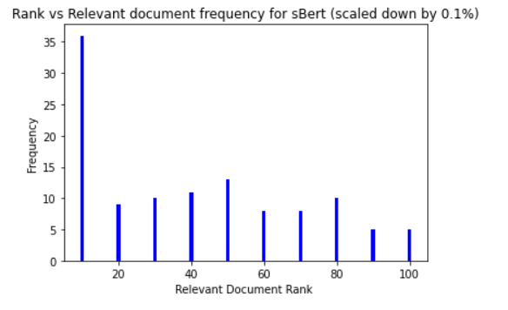
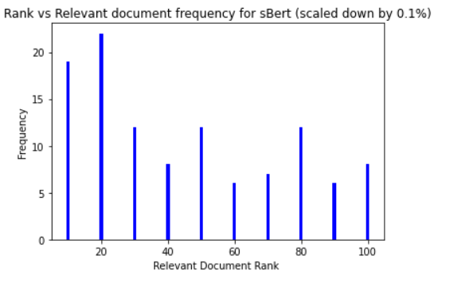
SBERT
Sentence Transformers
distilroberta-base-msmarco-v2
code
Mean Pooling
Max Pooling

Slide 13
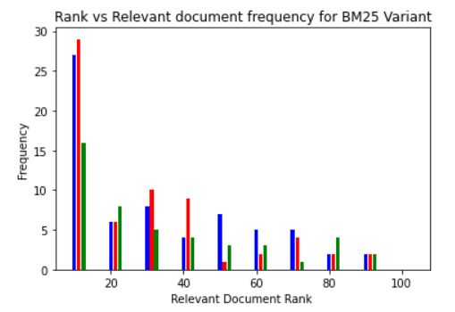
ANALYSIS
Blue- BM25 Okapi
Red- BM25Plus
Green- BM25L

Slide 14
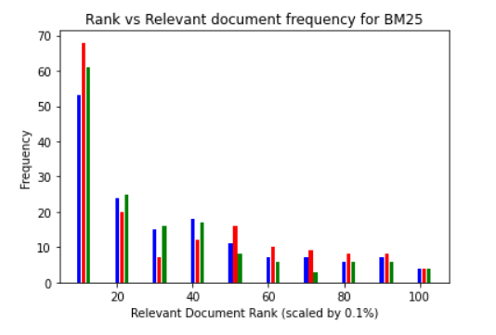
Blue - no preprocessing
Red- stopword removal and lowercasing
Green- stopword removal,stemming,lowercasing, punctuation removal

Slide 15
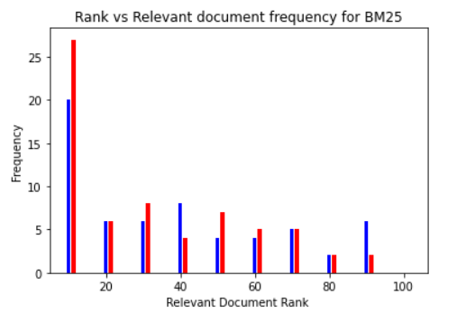
Document in top 10:
Blue- Named entity recognition
Red- Without named entity recognition

Slide 16
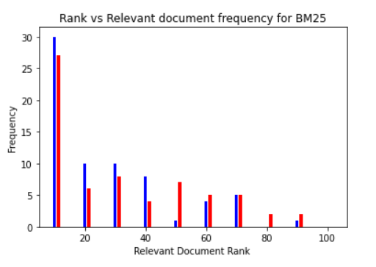
Blue- Tf-idf cosine similarity*BM25
Red- BM25 only

Slide 17
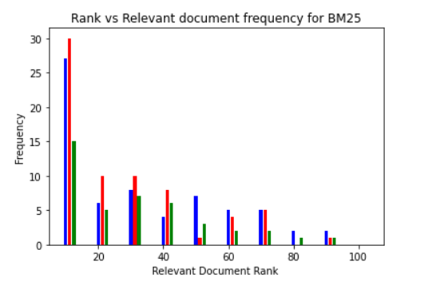
Blue- BM25
Red - TF-IDF cosine similarity *BM25
Green-number of common word*BM25

Slide 18
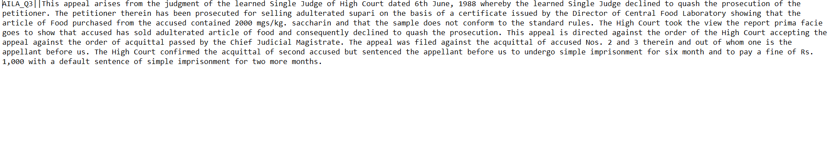
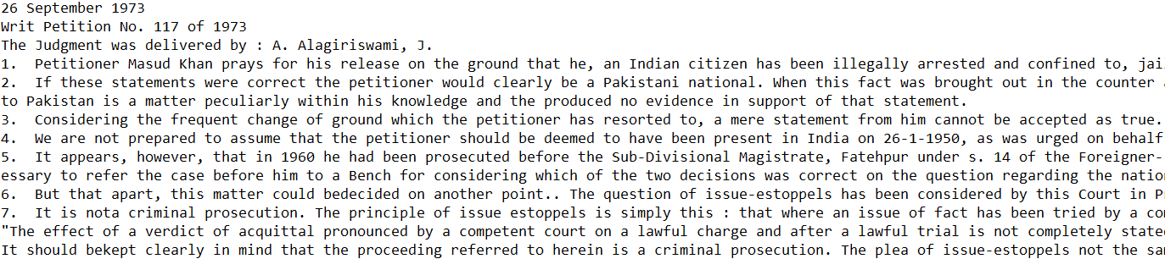
Comparison of query and relevant document

Slide 19
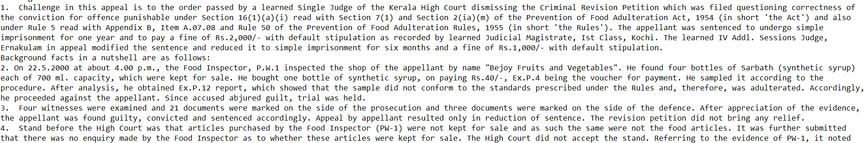
Comparison of query and relevant document
Link

Slide 20
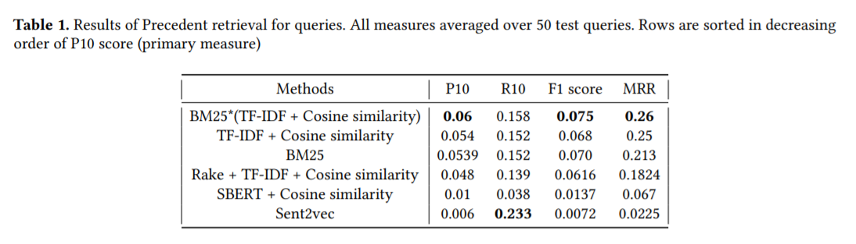
RESULTS

Slide 21
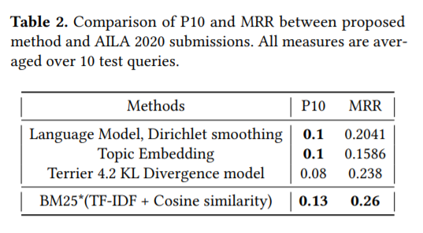

Slide 22
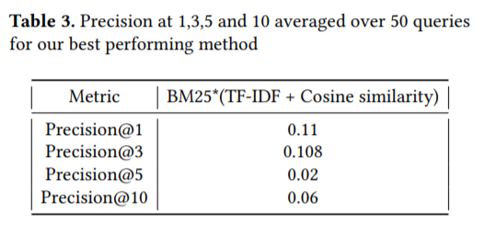

Slide 23
Future Work
Using domain specific BERT to generate better embeddings
Example: [2010.02559] LEGAL-BERT: The Muppets straight out of Law School
Fine tune or train from scratch BERT on Indian legal documents to capture semantic meaning of the documents.

Slide 24
References
SentenceTransformers Documentation — Sentence-Transformers documentation
Improvements to BM25 and Language Models Examined
Sent2vec.bin
Law-AI/semantic-segmentation
(RAKE) Automatic Keyword Extraction from Individual Documents

